Slide 1
Scheduling Transactions Under High Contention
Guna Prasaad
Advisors: Alvin Cheung, Dan Suciu

Slide 2

Transactions
Invented in 1980s by Jim Gray & others
Inspired by business contracts
Atomic unit of communication with a database
Lots of research in the past
Renewed interest
Jim Gray

Slide 3
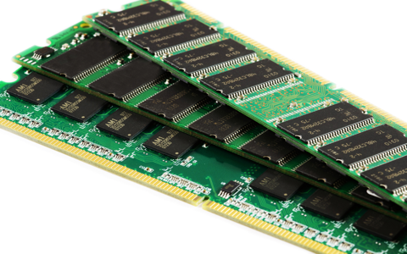
Modern Transaction Processing
Cheap Memory
Multicore Parallelism
Multicore In-Memory Databases

Slide 4
Traditional Systems

Slide 5
New Overheads
Concurrency Control

Slide 6
Recent Research
How to decrease concurrency control overhead?
Low contention workloads
Reducing false aborts
Improving traditional protocols
Cache-efficient Designs
Removing serial bottlenecks

Slide 7
Today’s Talk
Strife
Eliminates concurrency control
Intelligently scheduling transactions
Focus on high contention

Slide 8
Outline
Transactions 101
Transactions 101
Handling High Contention
Strife Execution Scheme
Scheduling Algorithm
Empirical Evaluation
Conclusion

Slide 9
Transactions 101
Atomicity
Consistency
Isolation
Durability

Slide 10
Isolation
Serializability

Slide 11
Isolation
Serializability

Slide 12
Isolation
Serializability

Slide 13
Conflicts
T2
T1
Begin
Begin
Write A
Read-Write
Write C
Write C
Read A
Write-Write
Read B
Read B
Commit
Commit

Slide 14
Concurrency Control Protocols
Pessimistic
Optimistic
Multi-Version
Partitioned & Deterministic

Slide 15
Concurrency Control Protocols
Pessimistic
Optimistic
Multi-Version
Partitioned & Deterministic

Slide 16
Concurrency Control Protocols
?
Pessimistic
Optimistic
Multi-Version
Partitioned & Deterministic

Slide 17
Concurrency Control Protocols
?
Pessimistic
Optimistic
Multi-Version
Partitioned & Deterministic

Slide 18
Concurrency Control Protocols
Pessimistic
Optimistic
Multi-Version
Partitioned & Deterministic

Slide 19
Outline
Transactions 101
Transactions 101
Handling High Contention
Strife Execution Scheme
Scheduling Algorithm
Empirical Evaluation
Conclusion

Slide 20
Contention
Measure of number of conflicts due to a data item

Slide 21


High Contention

Slide 22
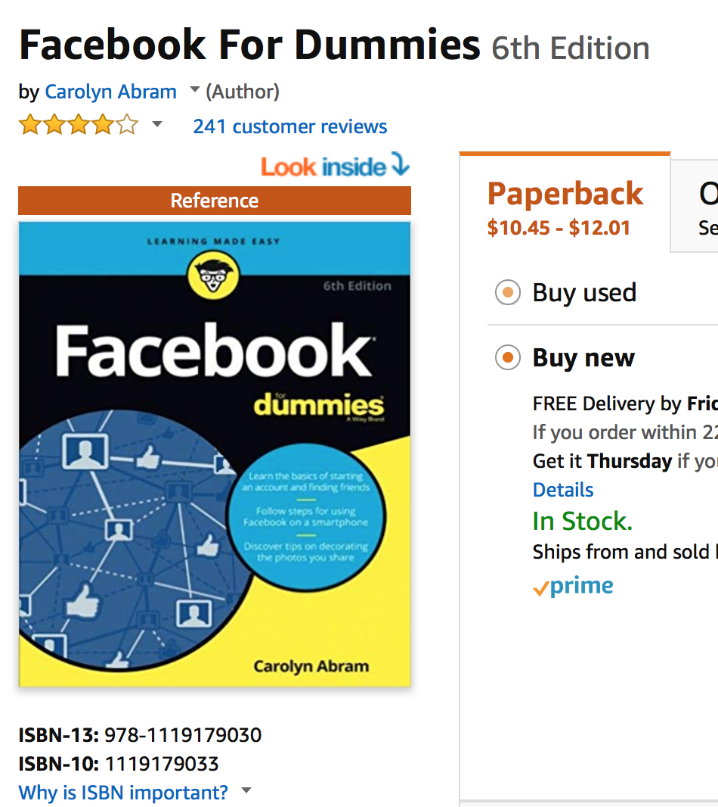
Low Contention

Slide 23
What happens under high contention?

Slide 24
(Wait) Pessimistic Protocol
Lock A
Lock A
Lock A
Lock A
Lock A
Lock A
Lock A
Unlock

Slide 25
(Abort) Pessimistic Protocol
Lock A
Lock A
Lock A
Lock A
Lock A
Lock A
Lock A
Unlock

Slide 26
Optimistic Protocol
Read A
Read A
Read A
Write A
Read A
Read A
Read A
Write A
Write A
Write A
Read A
Write A
Write A
Write A
Validate
Validate
Validate
Validate
Validate
Validate
Validate
Validate
Validate
Validate
Validate
Validate
Validate
Validate

Slide 27
Isn’t this fundamentally limited by serializability?

Slide 28
What if there are several hot items?

Slide 29
Runtime Breakdown

Slide 30
Can we avoid concurrency control while exploiting parallelism?

Slide 31
Outline
Transactions 101
Transactions 101
Handling High Contention
Strife Execution Scheme
Scheduling Algorithm
Empirical Evaluation
Conclusion

Slide 32
Status Quo
Stored Procedure
Read-Write Set

Slide 33
Strife Model
Execute them in “small” batches

Slide 34
Access Graph
T1
T3
A
T2
T1
A G C
F H E
B
D A C
T2
C
T3
D
T6
T4
T4
E
T5
B E F
A D
G
T5
F
B F H
T6
G
H

Slide 35
Key Insight
A
A
A
T1
T1
T1
B
B
B
T2
T2
T2
Conflict
Same Core
C
C
C
T3
T3
T3
D
D
D
T4
T4
T4
E
Conflict-free
Different Cores
E
E
T5
T5
T5
F
F
F
T6
T6
T6
G
G
G
H
H
H

Slide 36
Naïve Scheme
A
T1
B
T2
C
T3
D
T4
E
T5
F
T6
G
H

Slide 37
Naïve Scheme
A
T1
G
C
T2
T1
T3
D
T6
T2
T4
E
T3
F
T4
T6
T5
B
T5
H

Slide 38
Naïve Scheme
A
T1
G
C
T2
D
T6
E
T3
F
T4
B
T5
H

Slide 39
Naïve Scheme
A
T1
G
T2
C
T1
T7
T6
Conflict-Free Clusters
D
T2
T8
T7
T6
T3
T8
E
T4
T5
T3
F
T4
B
T5
H

Slide 40
Strife Execution Scheme
A
T1
G
T2
T1
T7
C
T7
T6
Conflict-Free Clusters
D
T8
T2
T8
T7
T7
T6
T3
T8
T8
E
T4
T5
T3
F
T4
B
T5
H

Slide 41
Strife Execution Scheme
A
T1
G
T2
T3
C
T1
T6
Conflict-Free Clusters
D
T2
T5
T7
T7
T6
T4
T8
T8
E
T3
F
T4
Residual Cluster
T7
T8
B
T5
H

Slide 42
Strife Execution Scheme
Analysis
Conflict-Free
Residual
Without Concurrency Control
With Concurrency Control

Slide 43
Strife Execution Scheme
Analysis
Analysis
Conflict-Free
Conflict-Free
Residual
Residual
Waiting
Batch 1

Slide 44
Strife Execution Scheme
Analysis
Analysis
Conflict-Free
Conflict-Free
Residual
Residual
Batch 2

Slide 45
Residual vs. Conflict-Free
How many residuals to allow?
No residuals
All residuals
Reduction in parallelism
Traditional OLTP

Slide 46
Residual vs. Conflict-Free
How many residuals to allow?
$$|R|≤α|B|$$
Currently user-supplied Can be learnt

Slide 47
Scheduling Problem
C1
C3
C3
Cn
…
R
B
No conflicts between Ci and Cj
|R|
$$≤α$$
|B|

Slide 48
Outline
Transactions 101
Transactions 101
Handling High Contention
Strife Execution Scheme
Scheduling Algorithm
Empirical Evaluation
Conclusion

Slide 49
Existing Solutions
NP-Hard
K-way Min-Cut Optimisation
Search over a SMT Problem
Integer Linear Program
Approximate Graph Partitioning
K-Means Clustering

Slide 50
Existing Solutions
Poorer Solution
Computationally Expensive

Slide 51
Strife Scheduler
Spot
Allocate
Merge

Slide 52
Strife Scheduler
Spot
Identify seed transactions using random sampling
Allocate
Allocate transactions to one of conflict-free clusters or residual cluster
Merge
Merge some conflict-free clusters (if necessary)

Slide 53
Strife Scheduler
Spot
Allocate
Merge

Slide 54
Spot Stage
Pick T at random
0 Clusters
Allocate
Else
Reject
k times

Slide 55
Spot Stage
Pick T at random
Pick T at random
0 Clusters
0 Clusters
Allocate
Allocate
Else
Reject
k times

Slide 56
Spot Stage
Pick T at random
Pick T at random
0 Clusters
0 Clusters
Allocate
Allocate
Else
Reject
k times

Slide 57
Spot Stage
Pick T at random
Pick T at random
0 Clusters
Allocate
Else
Else
Reject
Reject
k times

Slide 58
Spot Stage
Pick T at random
Pick T at random
0 Clusters
0 Clusters
Allocate
Allocate
Else
Reject
k times

Slide 59
Spot Stage
Pick T at random
Pick T at random
0 Clusters
0 Clusters
Allocate
Allocate
Else
Reject
k times

Slide 60
Spot Stage
Pick T at random
Pick T at random
0 Clusters
Allocate
Else
Else
Reject
Reject
k times

Slide 61
Spot Stage
Pick T at random
0 Clusters
Allocate
Else
Reject
k times

Slide 62
Spot Stage
Identify seed transactions using random sampling
Probability that we allocate a hot item is high!
Probability that we choose a residual transaction is small!

Slide 63
Allocate Stage
Scan all transactions
0 Clusters
Skip
1 Cluster
Allocate
Else
Residual

Slide 64
Allocate Stage
Scan all transactions
0 Clusters
Skip
1 Cluster
1 Cluster
Allocate
Allocate
Else
Residual

Slide 65
Allocate Stage
Scan all transactions
0 Clusters
0 Clusters
Skip
Skip
1 Cluster
Allocate
Else
Residual

Slide 66
Allocate Stage
Scan all transactions
0 Clusters
Skip
1 Cluster
Allocate
Else
Else
Residual
Residual

Slide 67
Allocate Stage
Scan all transactions
0 Clusters
Skip
1 Cluster
Allocate
Else
Residual

Slide 68
Allocate Stage
What about skipped transactions?
More data items allocated. Maybe we don’t need to skip now!
If still none allocated, we randomly allocate to one of the seed clusters

Slide 69
Allocate Stage
Scan skipped transactions
0 Clusters
Random Allocate
1 Cluster
Allocate
Else
Residual

Slide 70
Allocate Stage
Scan skipped transactions
0 Clusters
Random Allocate
1 Cluster
1 Cluster
Allocate
Allocate
Else
Residual

Slide 71
Allocate Stage
Scan skipped transactions
0 Clusters
0 Clusters
Random Allocate
Random Allocate
1 Cluster
Allocate
Else
Residual

Slide 72
Allocate Stage
Scan skipped transactions
0 Clusters
Random Allocate
1 Cluster
Allocate
Else
Residual

Slide 73
Merge Stage
Size of residual cluster can be large
Merge clusters that have resulted in large number of residuals
$$R(C_{i},C_{j})>α\left(R(C_{i},C_{j})+|C_{i}|+|C_{j}|\right)$$

Slide 74
Merge Stage
Merge Clusters, if necessary
Scan through residuals
1 Cluster
Allocate

Slide 75
Merge Stage
Merge Clusters, if necessary
Scan through residuals
1 Cluster
Allocate

Slide 76
Merge Stage
Merge Clusters, if necessary
Scan through residuals
1 Cluster
Allocate

Slide 77
Merge Stage
Merge Clusters, if necessary
Scan through residuals
1 Cluster
Allocate

Slide 78
Our Solution
Spot
Identify seed transactions using random sampling
Allocate
Allocate transactions to one of conflict-free clusters or residual cluster
Merge
Merge some conflict-free clusters (if necessary)

Slide 79
Strife

Slide 80
Strife

Slide 81
Outline
Transactions 101
Transactions 101
Handling High Contention
Strife Execution Scheme
Scheduling Algorithm
Empirical Evaluation
Conclusion

Slide 82
Strife Implementation
Pre-Process
Spot
Allocate
Merge
Parallelism
Parallel
Thread-Local Data Structures
Parallel
Atomic Instructions
Parallel
10K Transactions

Slide 83
Baselines
Pessimistic Protocols
No-Wait
Lock-Ordered
Wait-Die
Waits-For-Graph

Slide 84
TPC-C
Warehouse
Warehouse
Item
Payment
New-Order
District
Stock
25% Remote
Customer

Slide 85
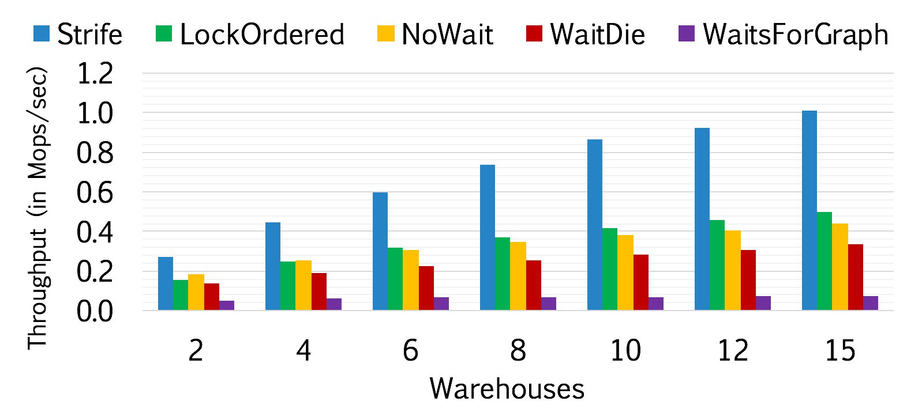
Contention (warehouses)
15 Cores

Slide 86
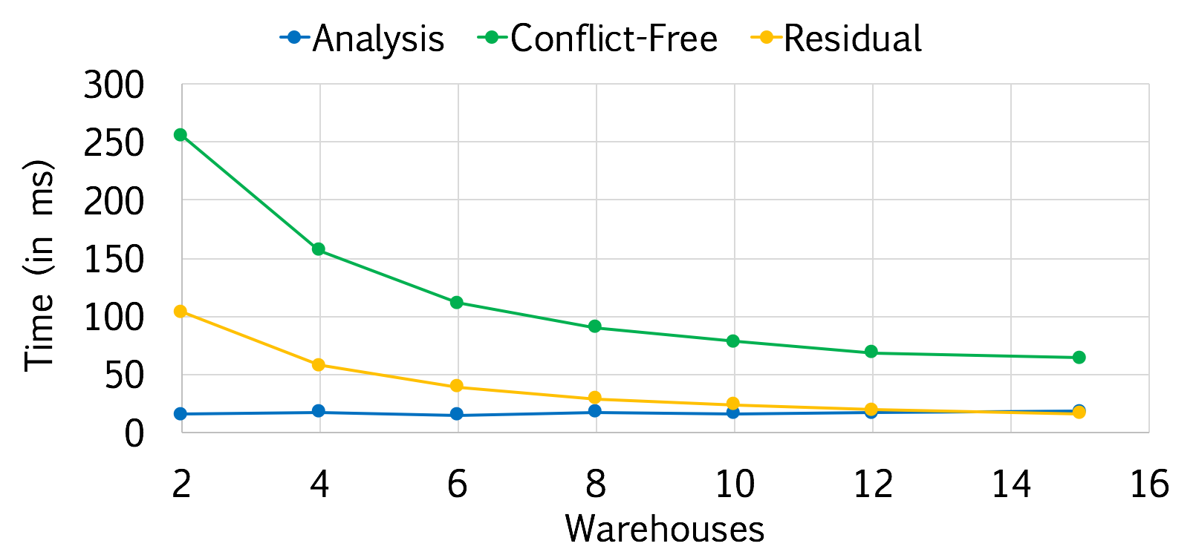
Runtime Breakdown
15 Cores

Slide 87
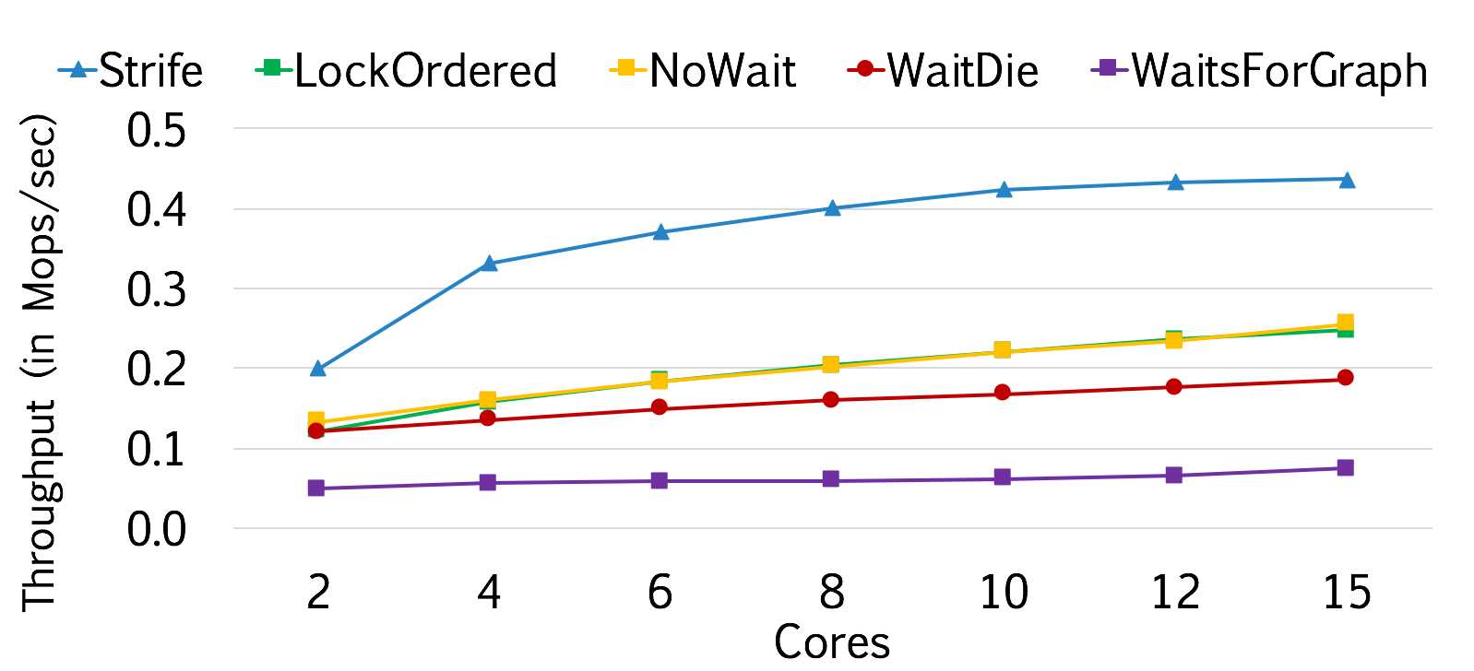
Scalability
4 Warehouses

Slide 88
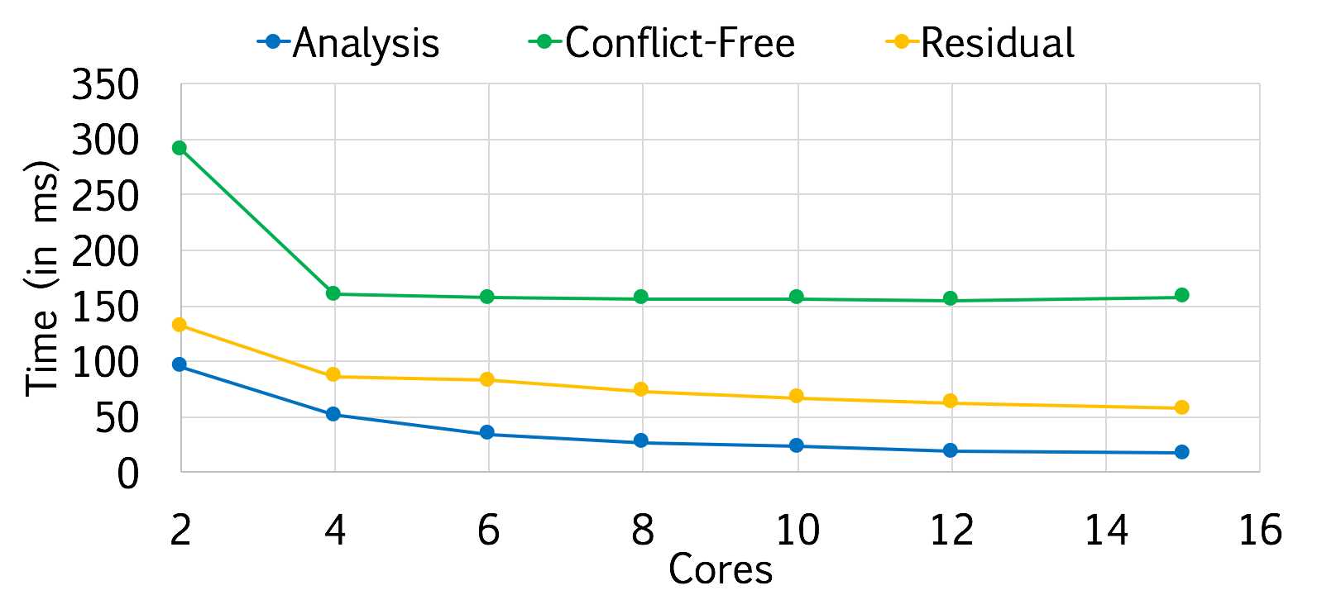
Runtime Breakdown
4 Warehouses

Slide 89
YCSB
One Partitioned Table
Read/Write Transaction
10 Million Keys
Single Partition
128 byte Values
20 Accesses
Zipfian Distribution
50% Read-Write

Slide 90
YCSB
One Partitioned Table
Read/Write Transaction
100 Keys, 10000 Samples for various theta

Slide 91
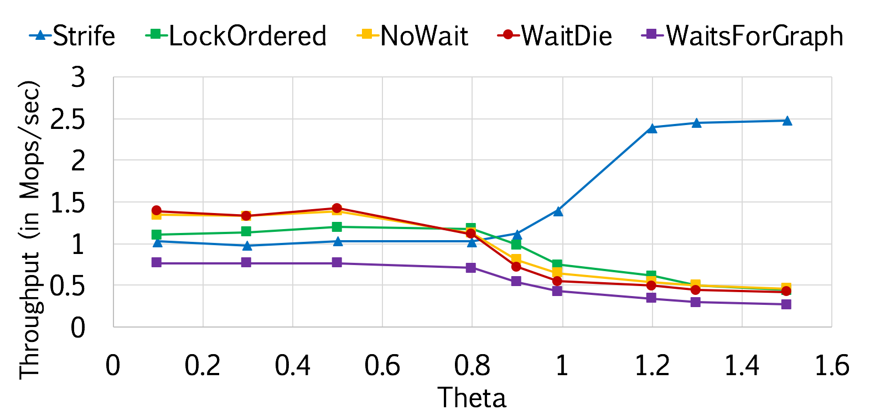
Contention (theta)
15 Partitions, 15 Cores

Slide 92
Outline
Transactions 101
Transactions 101
Handling High Contention
Strife Execution Scheme
Scheduling Algorithm
Empirical Evaluation
Conclusion

Slide 93
Strife
Proposed a novel execution scheme for OLTP systems
Presented a low-overhead scheduling algorithm to handle high contention workloads
A speedup of upto 2x compared to pessimistic protocols
Demonstrated that avoiding concurrency control can be good for modern transaction processing

Slide 94
“The important problem facing humanity in the 21st century is transaction processing.”
– Abraham Lincoln, 1864

